Slide 1
Introduction to Data Mining
Carsten Schürmann

Slide 2
What is it?
Data-mining is the science of discovering structure and making predictions in datasets
Unsupervised learning: Structure
Given observations X₁, X₂, …, X_{n} learn group structure based on similarity
Supervised learning: Predictions
Given observations and classifications
(X₁, Y₁), (X₂, Y₂), …, (X_{n}, Y_{n}) learn a model
to predict Y from X

Slide 3
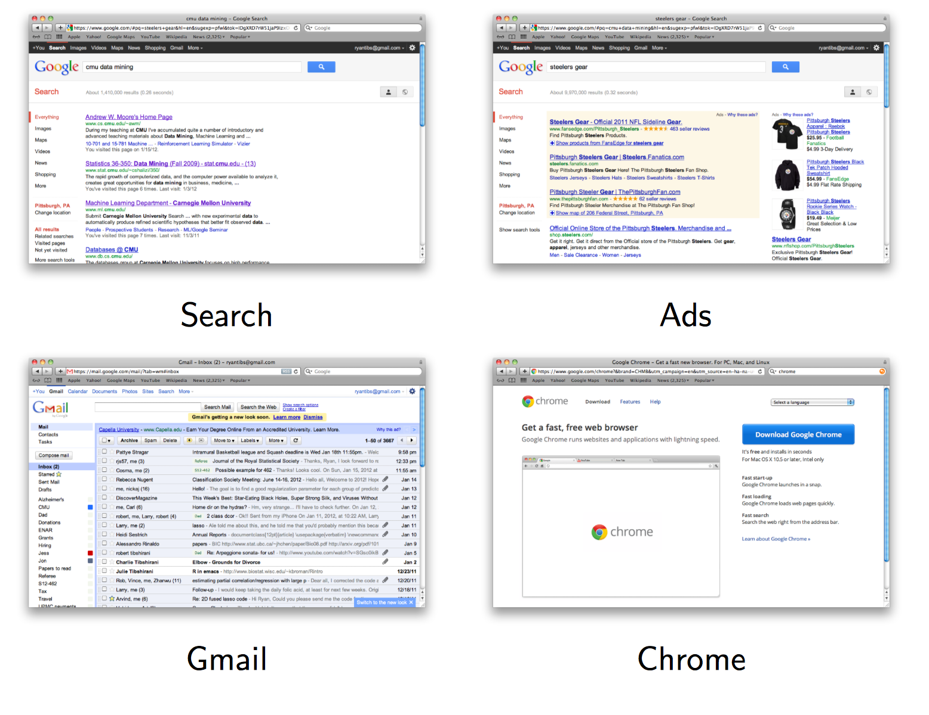
Google

Slide 4


Slide 5


Slide 6
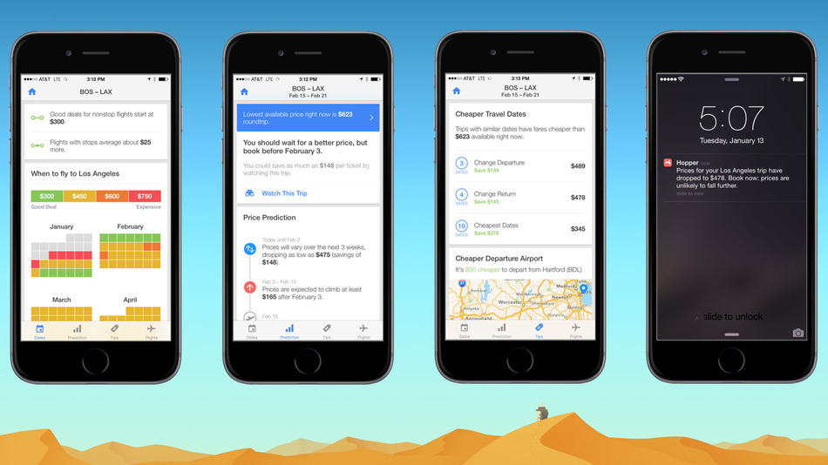
Airfare Prediction

Slide 7
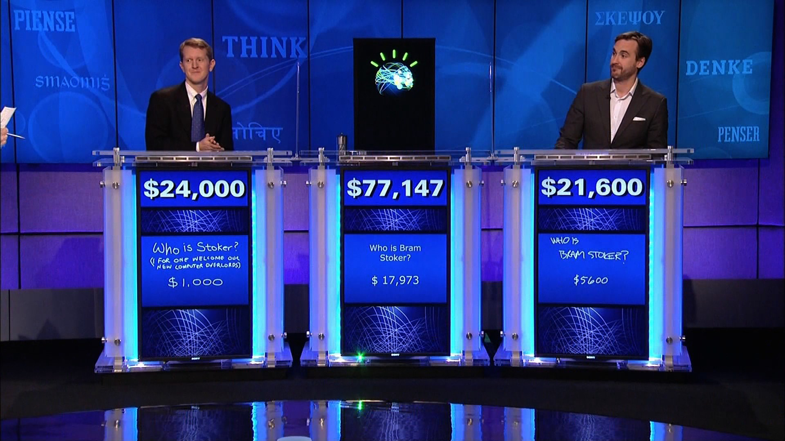
IBM’s Watson in Jeopardy
https://youtu.be/WFR3lOm_xhE

Slide 8
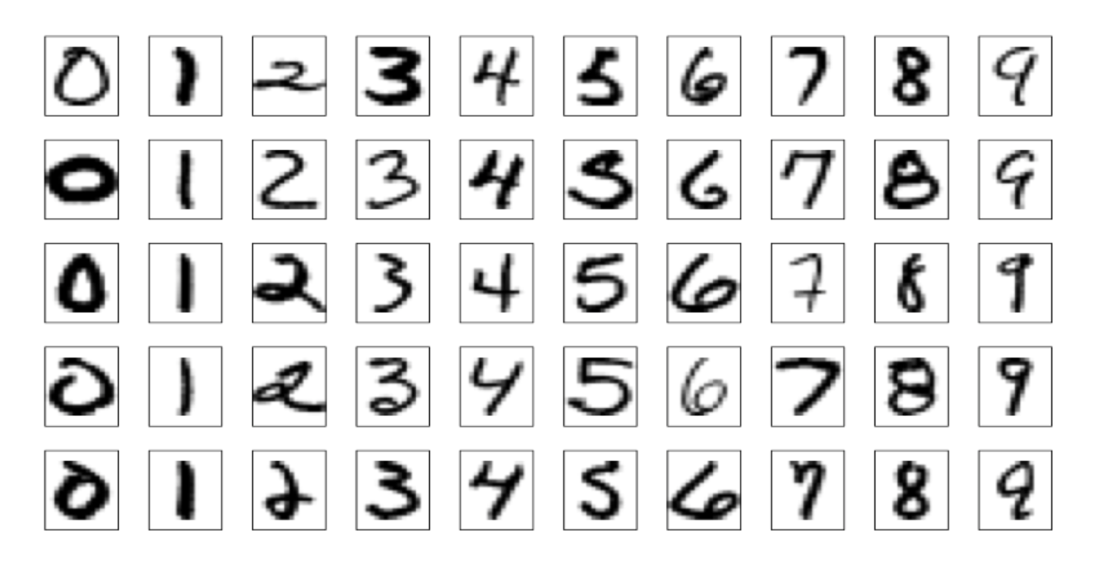
Handwritten Postal Codes

Slide 9
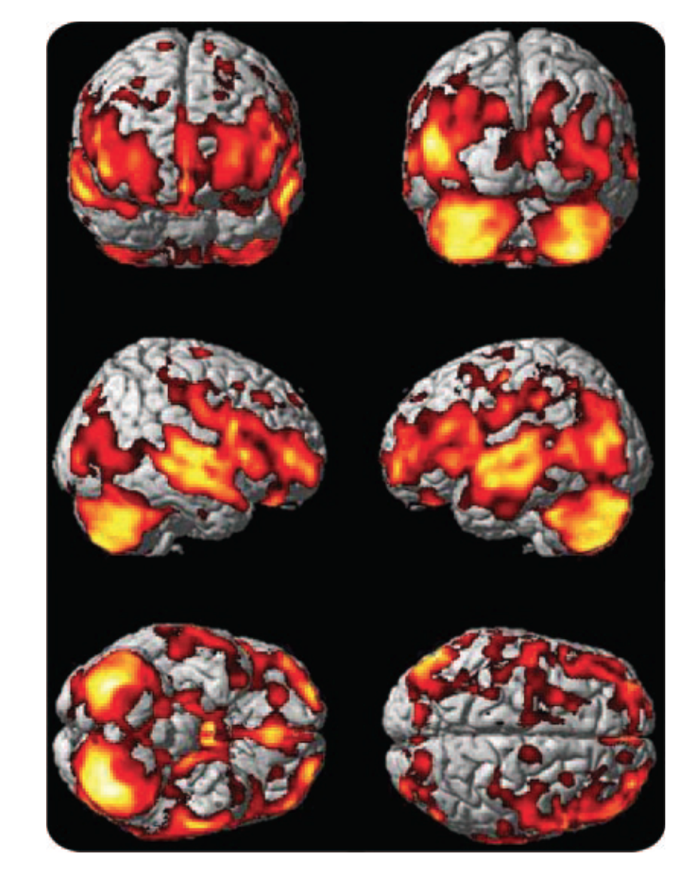
Predicting Alzheimer’s Disease

Slide 10
Bias-Variance Dilemma
Bias: error from erroneous assumptions in the learning algorithm. High bias leds to underfitting.
Variance: is error from sensitivity to small fluctuations in the training set. High variance can cause overfitting.

Slide 11
Information Retrieval

Slide 12
Text Similarity
Documents:
X₁: “John loves statistics” X₂: “Jess hates, hates statistics”
Query:
Y: “hates statistics”
Document-term matrix:
 | hates | Jess | loves | Ryan | statistics
X₁ | 0 | 0 | 1 | 1 | 1
X₂ | 2 | 1 | 0 | 0 | 1
Y | 1 | 0 | 0 | 0 | 1

Slide 13
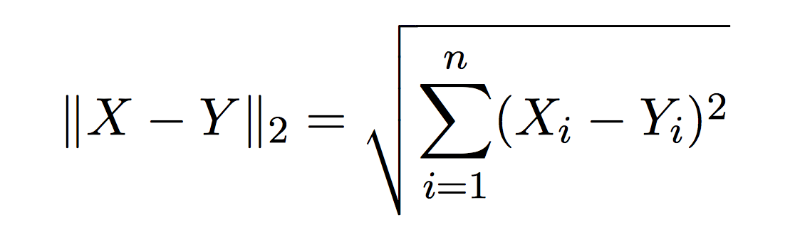
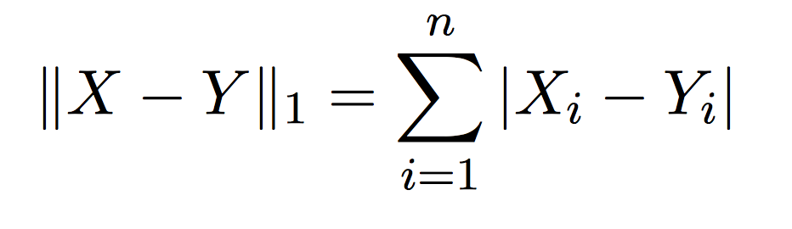
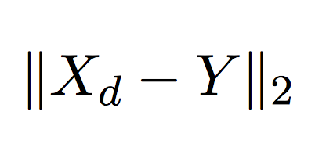
Vectors, Metrics, Retrieval
Euclidian distance:
Manhattan distance:
Retrieval: Find d, with shortest distance to the query: minimal

Slide 14

Page Rank
Central idea behind
Assign a rank to each page
Compute the rank from the linking edges weighted appropriately by their own page rank
“Recursive defintion”
Page rank algorithm, computes the rank, i.e. importance of each page iteratively
Ingredients. Matrices, Markov chains.

Slide 15
Clustering

Slide 16
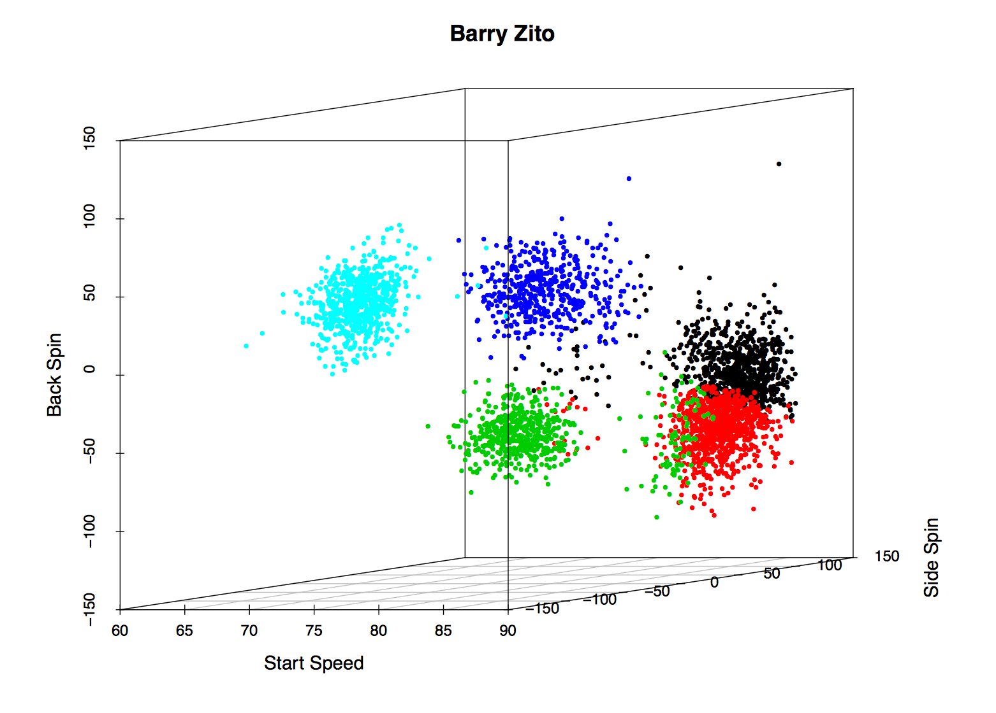
Baseball Pitches
Inferred meaning of clusters: black – fastball, red – sinker,
green – changeup, blue – slider, light blue – curveball

Slide 17
k-Means Clustering
Given: n vectors (representing observations x_{i})
Problem: Find k clusters (centered in c_{k})
Step 1: Place c_{k} at random in the space
Step 2: Assign each x_{i} to the closest c_{k}.
Step 3: Compute new centers c_{k} among those assigned.
Step 4: Goto step 2 until stable.

Slide 18
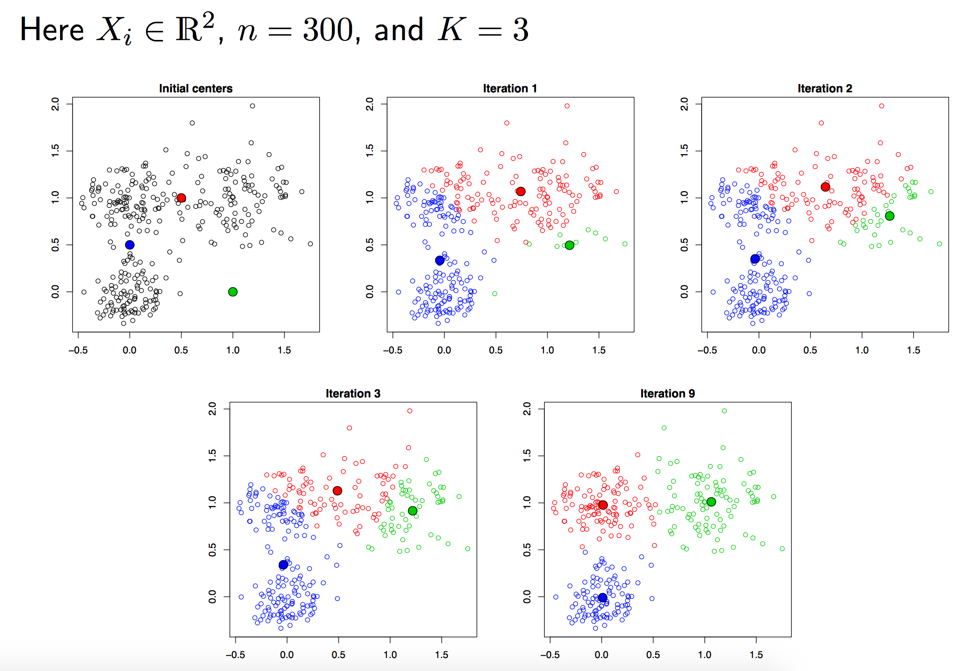

Slide 19
Properties of k-Means Clustering
Always reduces the distance
Always converges
May not converge in a global maximum

Slide 20
Hierarchical clustering algorithm
Given: n vectors (representing observations x_{i})
Problem: Find k clusters (centered in c_{k})
Step 0: Every vector forms a group
Step 1: Find nearest neighboring groups
Step 2: Merge them
Step 3: Goto 1 until there is only one group

Slide 21
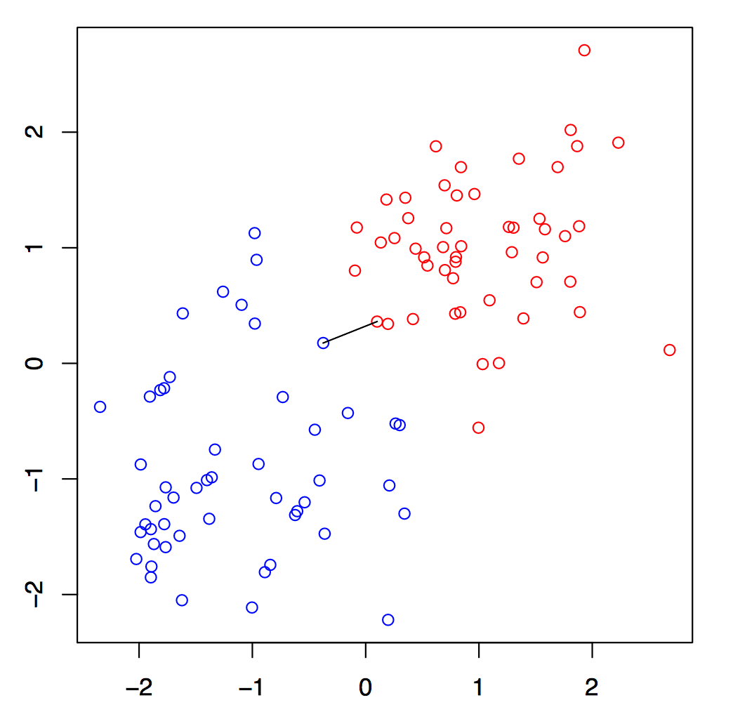
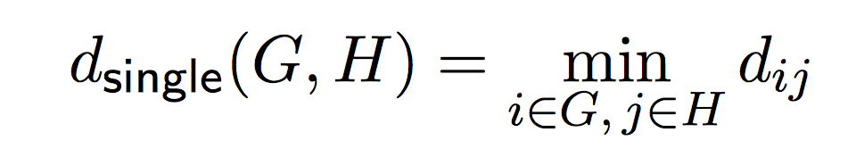
Single Linkage

Slide 22
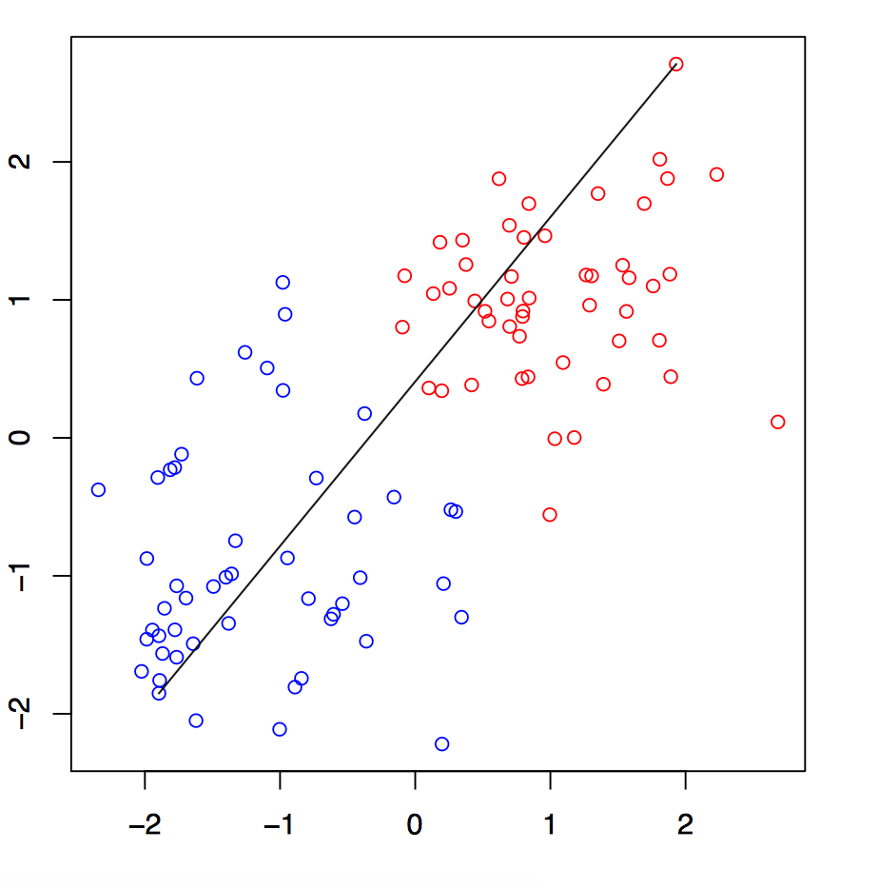
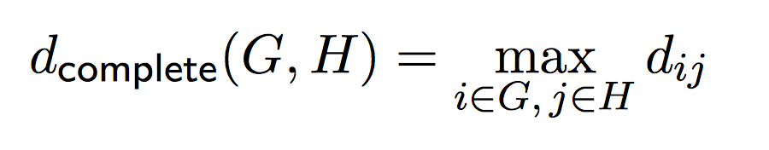
Complete Linkage

Slide 23
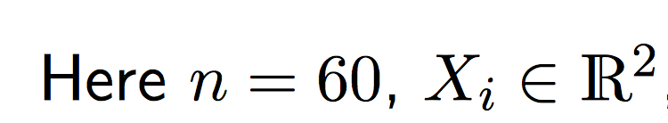
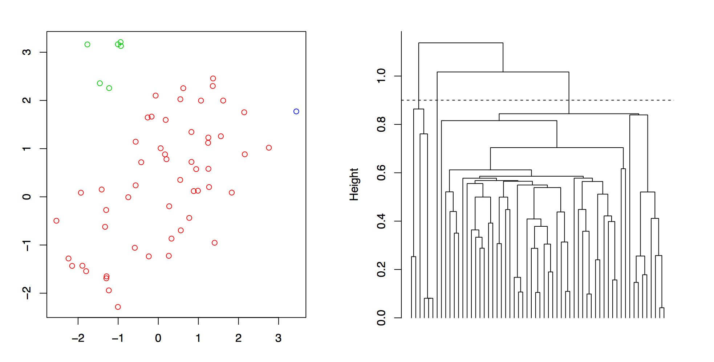

Slide 24
Properties
Single linkage avoids crowding but suffers from chaining.
Complete linkage avoids chaining, but suffers from crowding.
There is also average linkage
(not discussed here)

Slide 25
Regression

Slide 26
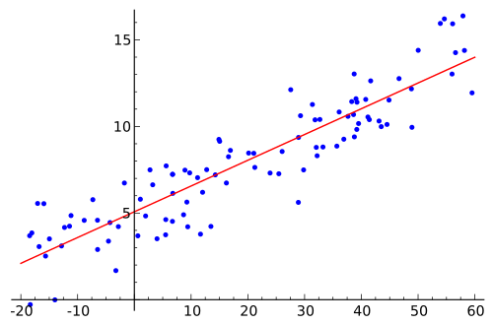
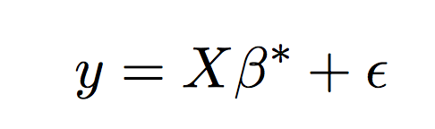
Linear regression

Slide 27
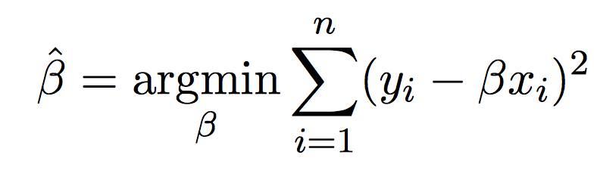
Least Square method
Compute the “best” coefficients that minimizes the squared error.
This is somewhat easy (Gauss figured it out when he was 18), but modern regression methods can get very very difficult

Slide 28
Classification Trees

Slide 29
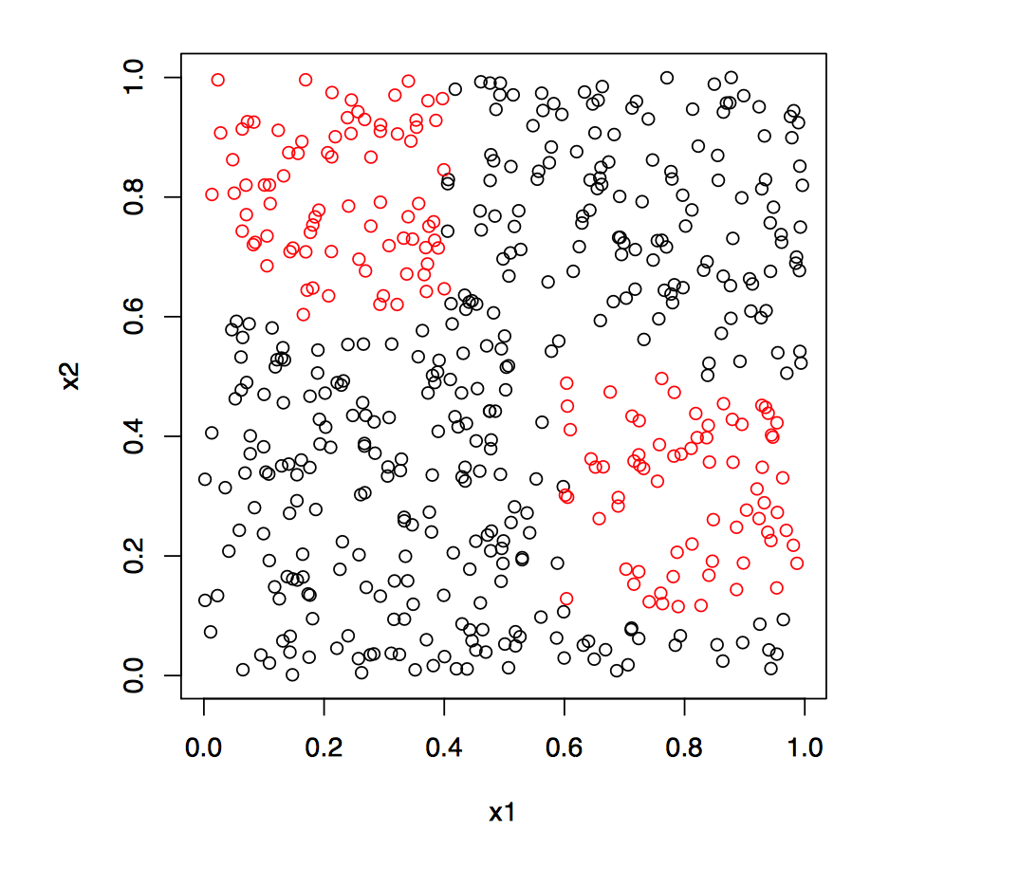
Example

Slide 30
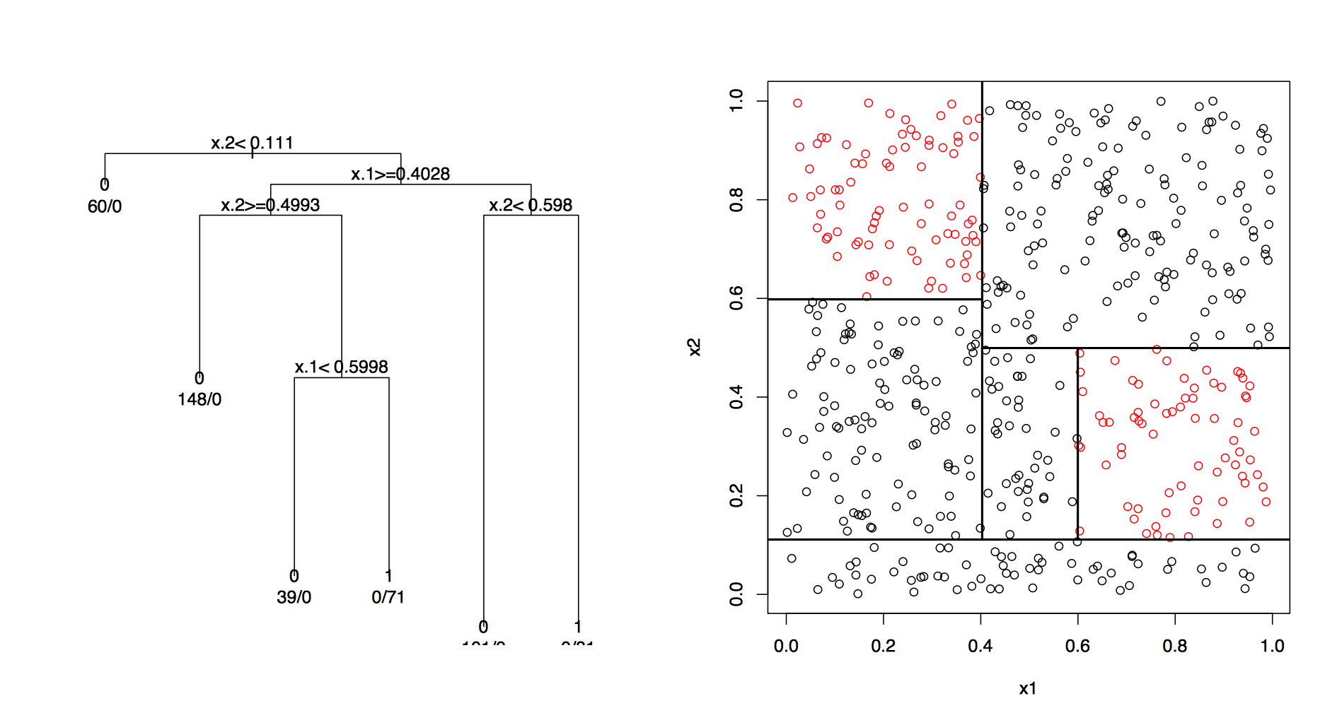
And the Classification Tree

Slide 31
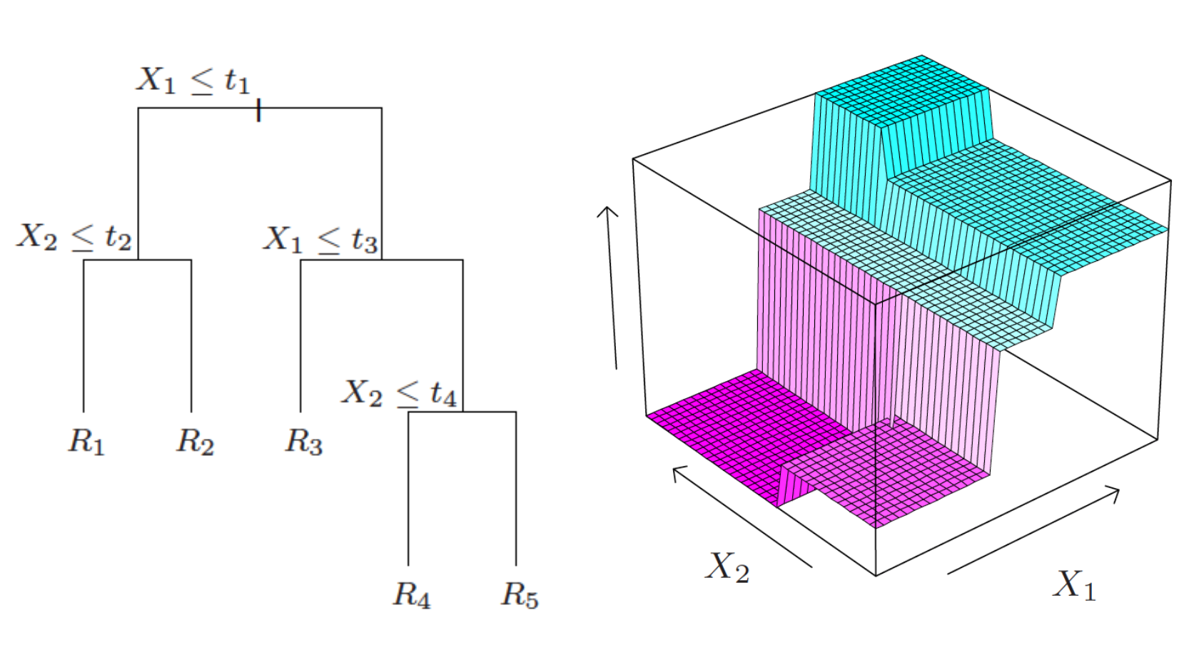
Continuous Classification Trees

Slide 32
Properties
Predicative abilities: Not so good.
Overfitting: if the granuarlity of the tree is too fine, then predictive abilities are even worse

Slide 33
Conclusion
Exact approach versus approximation: often when we can’t do something exactly, we’ll settle for an approximation. Can perform well, and scales well computationally to work for large problems
Bias-variance tradeoff: nearly every modeling decision is a tradeoff between bias and variance. Higher model complexity means lower bias and higher variance
Interpretability versus predictive performance: there is also usually a tradeoff between a model that is interpretable and one that predicts well under general circumstances

